Slide 1
Geometric Pattern Recognition (2015)
Introduction
Marc van Kreveld

Slide 2
About geometric patterns
A pattern is a discernible regularity in the world or in a manmade design. As such, the elements of a pattern repeat in a predictable manner.
A geometric pattern is a kind of pattern formed of geometric shapes and typically repeating like a wallpaper.
(Wikipedia)

Slide 3




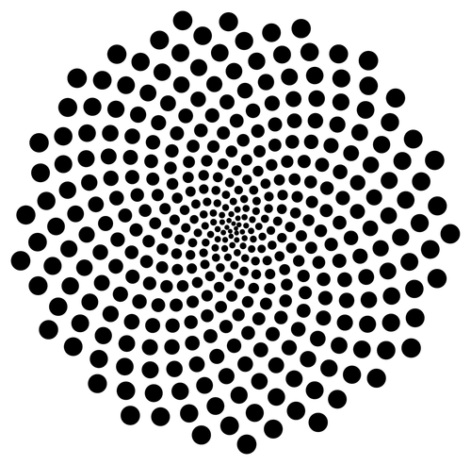
A picture gallery of patterns

Slide 4
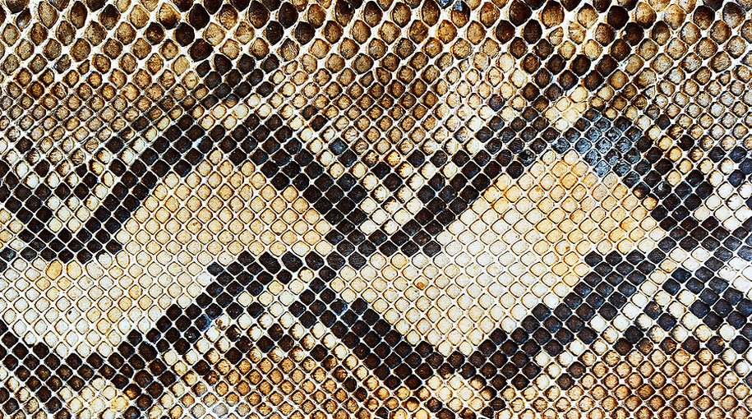


A picture gallery of patterns

Slide 5
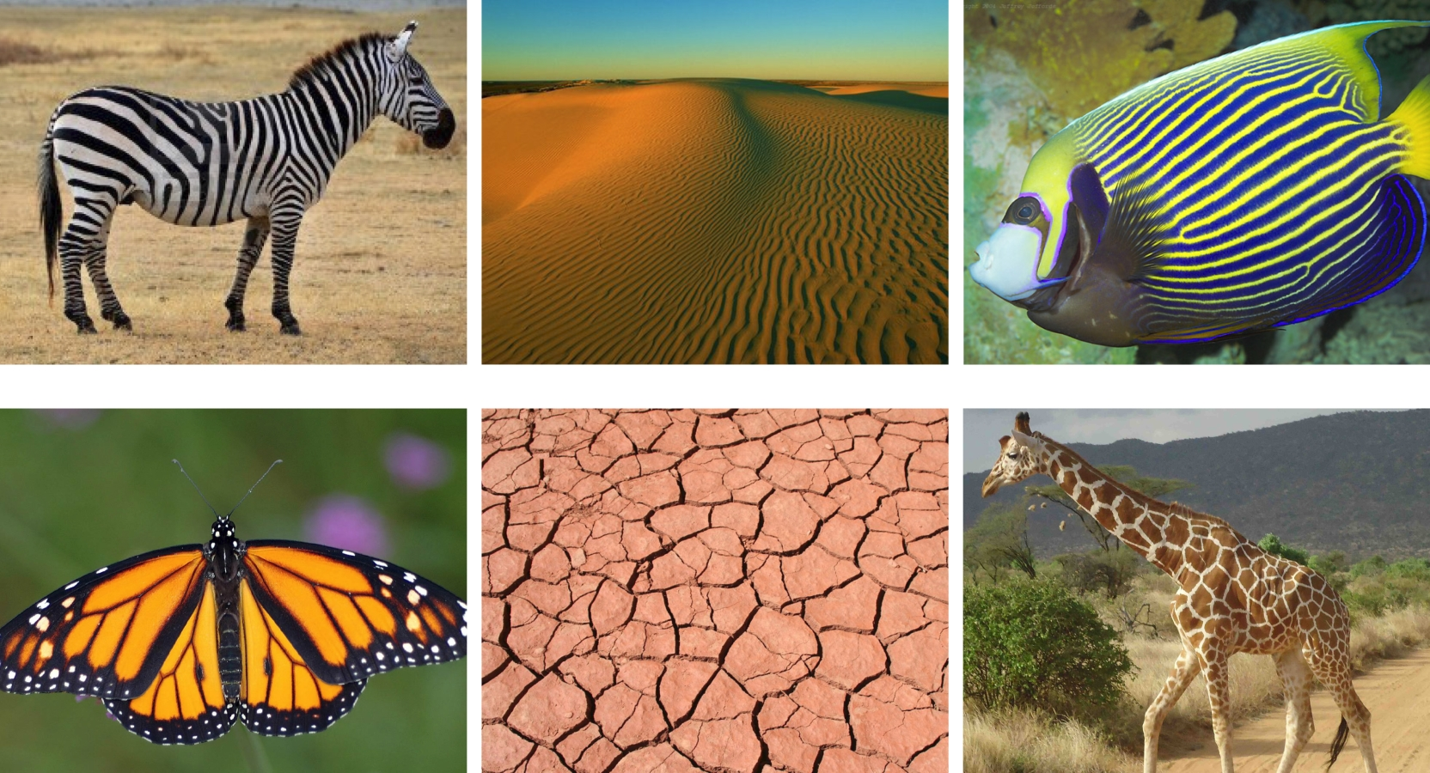
A picture gallery of patterns

Slide 6

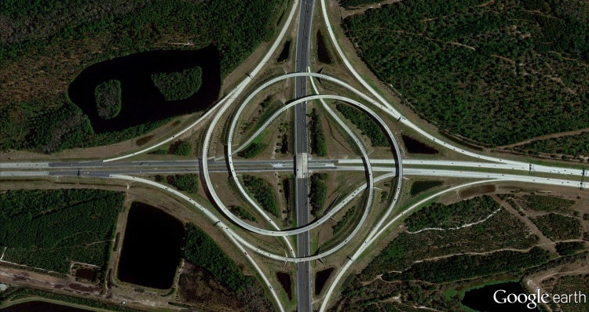

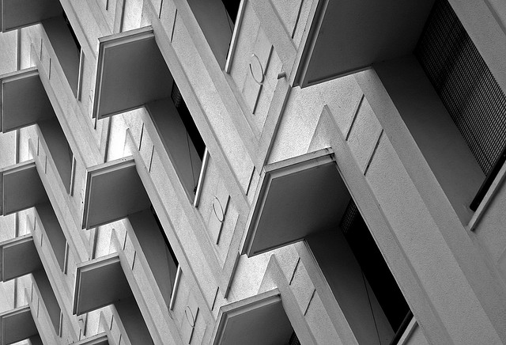
A picture gallery of patterns

Slide 7
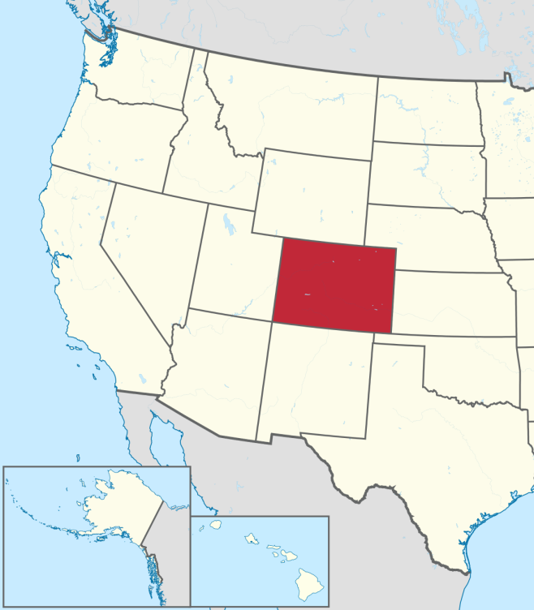
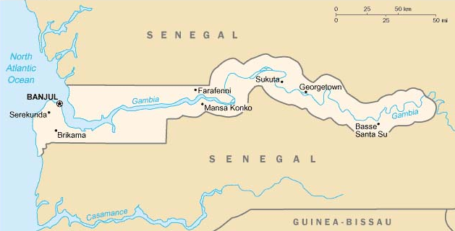
A picture gallery of patterns

Slide 8
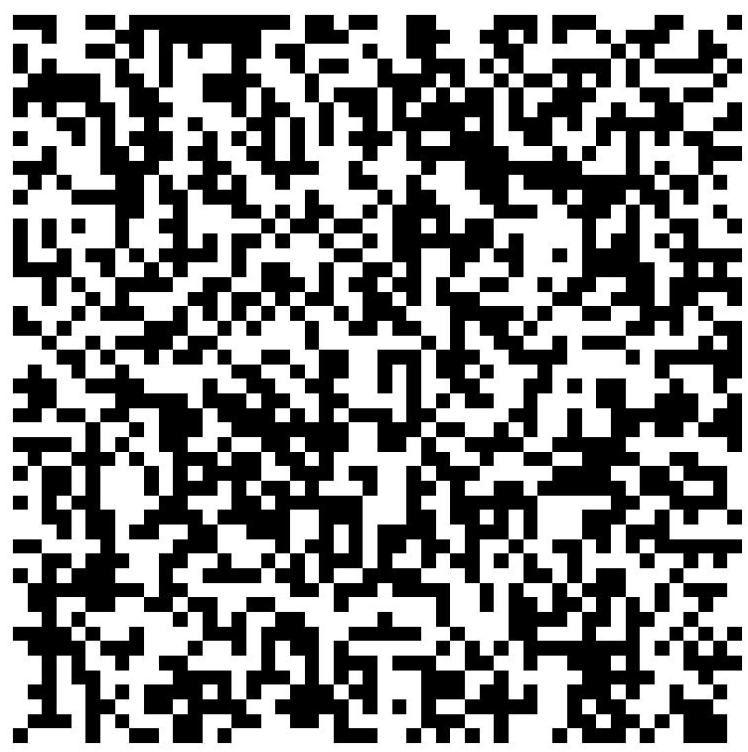
Geometric patterns
… occur in nature and as man-made things
… often show repetition
in a substructure
in an orientation
… sometimes show scale
where a substructure recurs in a smaller form
… show a deviation from randomness (although one may speak of a random pattern)
Notes:
The Mandelbrot set shows substructures (patterns) that occur at smaller and smaller scales. So do spiral patterns, like the shell.

Slide 9
Geometric patterns
… arise due to
spatial natural processes
spatial mathematical processes
preferences of living entities
… may have a time component, leading to spatio-temporal patterns
A spatial system may be self-organizing (and optimizing), leading to emerging patterns

Slide 10
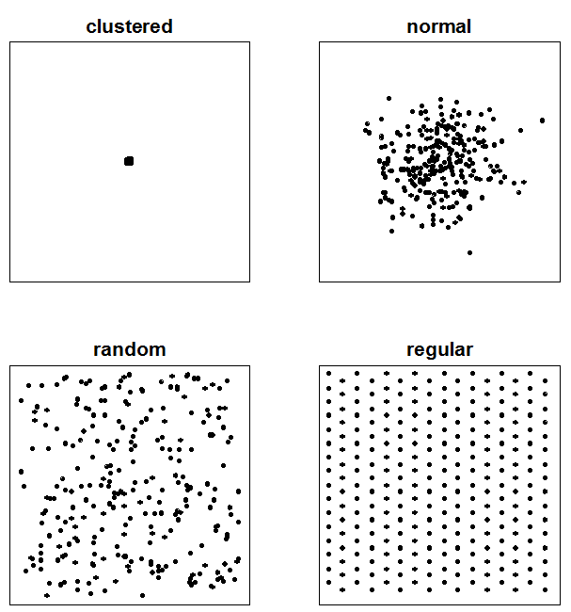
Geometric patterns
Patterns relate to statistical distributions Note: the clustered pattern could still look like the normal, random or regular distribution when we zoom in

Slide 11
Geometric patterns
How can we easily distinguish between these four patterns?
Measure for each point the nearest neighbor distance and make a histogram
Notes:
Using a histogram of the n nearest neighbor distances and comparing it to such histograms for normal, random and regular point sets

Slide 12
What kind of data?
Pixel images or voxel scenes
Point sets (point clouds)
Polygonal lines (crack, outline, path of a moving entity)
Polygons, polyhedra (shapes)
Networks (graphs are not geometric; embedded graphs are)
Scalar fields, vector fields
Time series (values over time of a variable)
Changing data (changing geometry over time)
Labeled point sets (for co-location patterns)

Slide 13
What kind of pattern?
Specific known shape
Repetition of a shape
Other deviations from randomness
dense areas
preferred orientations
…
Co-occurrence of different data

Slide 14
Looking for patterns
… in a given data set by looking for e.g. regularity or repetition or
… using a fixed, simple shape (circle, rectangle)
… using a known shape (template) We need the concept of similarity

Slide 15
Similarity
Subjective
… but can be defined (in many ways)
Similarity measure/function, versus distance measure/function = metric
Metric (math): on a set X; for any x,y,z in X, a function d(x,y) → R (the reals) where:
d(x,y) ≥ 0 non-negative
d(x,y) = 0 if and only if x = y coincidence
d(x,y) = d(y,x) symmetry
d(x,z) ≤ d(x,y) + d(y,z) triangle inequality

Slide 16



Similarity
Should (visual) distance really be a metric?
x
y
z

Slide 17

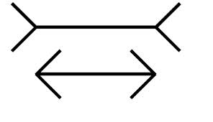
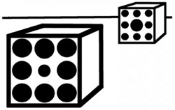
Measurable and perceptive similarity
Measureable similarity is something we define, it is objective and independent of a viewer
Perceptive similarity is subjective and dependent on a viewer, but there are general principles on how most humans perceive

Slide 18
What to match
The whole data set to a shape (matching)
A subset of the whole data set to a shape (partial matching)
In principle the whole data set, but there may be outliers

Slide 19
Allowing transformations
Possible transformations before matching = assessing similarity:
Translate
Translate and rotate (called rigid motion)
Translate and scale
Translate and rotate and scale (called similarity)

Slide 20
The applications
Paper document to digital form conversion
Text: OCR – optical character recognition
Old maps
Image scene analysis
Land-use or crops from satellite images
Traffic signs or road deterioration (potholes) from photos
Physical geography
Elevation land forms: drainage patterns, ridges, valley heads, volcanoes
River or delta land forms

Slide 21
The applications
Cyclic patterns in time series
weekly, monthly, yearly patterns in human-related data (unemployment, welfare)
yearly patterns in nature (due to seasons)
patterns in stock values
Behavior patterns in animal movement data
identifying foraging, directed flight, and resting from a bird track
formations (=pattern) of migrating birds
formations in schools of fish
growing micro-organisms

Slide 22
The applications
Identification (fingerprint, iris scan)
Geology
Archaeology
Meteorology
Astronomy
Electrophoresis

Slide 23
Geometric and statistical pattern recognition
Statistical pattern recognition is based on features
Features can be geometric → It is possible to perform geometric pattern recognition by extracting or computing geometric features and then performing statistical pattern recognition

Slide 24
The tools
Geometric structures:
Voronoi diagrams (for proximity, relative)
Minkowski sums (for proximity, absolute)
Arrangements (for outliers)
Alpha shapes (for shape extraction)
Geometric transformations: translate, rotate, scale, shear, reflect, …
Geometric summaries (descriptive statistics):
Center of gravity
Diameter
Spread

Slide 25
The tools
Geometric (similarity) measures
Geometric algorithms (for computations)
Concepts from topology and computational topology (for handling noise, scale and significance)
Persistence diagram
Reeb graph
Alpha complex

Slide 26
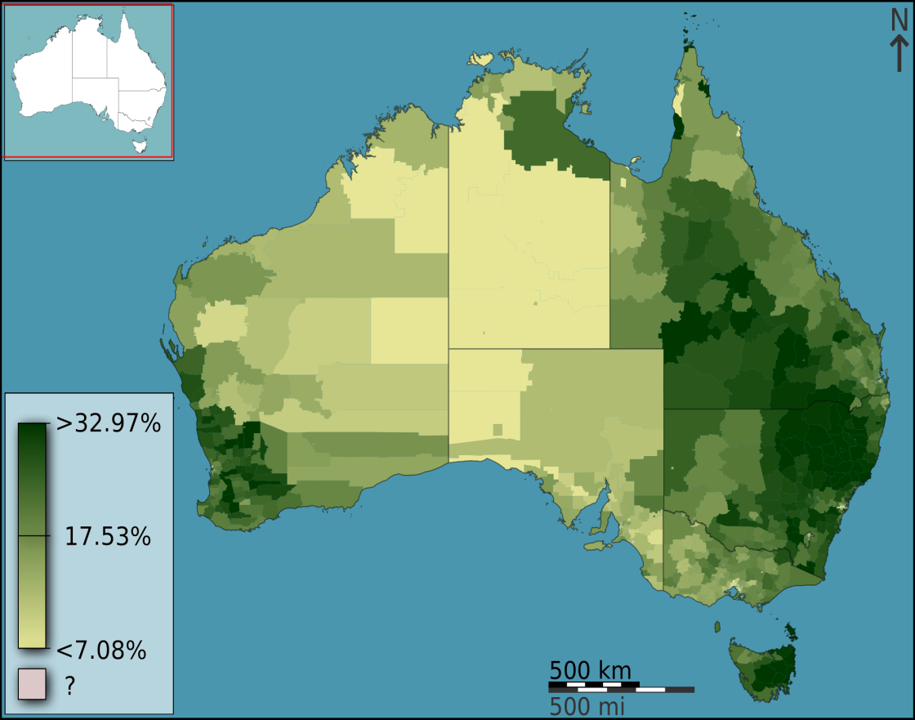
Not just fully automated
Tools for visualization to aid humans in data exploration and pattern recognition
geo-exploration
visual analytics
fraction of Australians that are Anglican

Slide 27
Overlap
3D modelling (BA)
Multimedia retrieval (MSc)
Geometric algorithms (MSc)
Data mining (MSc)

Slide 28
Course objectives
To become familiar with the main research questions, considerations, and solution techniques for geometric pattern recognition
geometric data and patterns
geometric similarity measures
geometric tools and algorithms
To know the main applications of geometric pattern recognition
To practise in brainstorming and structurally view pattern recognition questions
To practise in scientific writing

Slide 29
Schedule
16-12: Today, first lecture, introduction, data, project start
18-12: Geometry, patterns, measures and metrics, descriptive spatial statistics
X-mas break
6-1: Point pattern analysis
8-1: Point pattern analysis (continued), outliers
13-1: Class via Skype: trajectory analysis
15-1: No class!
20-1: Patterns in other geometric data, finding clusters
22-1: Presentations of projects (applications)

Slide 30
Experimenting on you
I am revamping Geometric Pattern Recognition
topics treated
slides used
project instead of practical assignment
I need your feedback!

